Slide 1
SPECIAL OLYMPICS GEORGIA VOLUNTEER ORIENTATION
STATE FALL GAMES

Slide 2
OUR MISSION
To provide year-round sports training and athletic competition in a variety of Olympic-type sports for all children and adults with intellectual disabilities, giving them continuing opportunities to develop physical fitness, demonstrate courage, experience joy, and participate in the sharing of gifts, skills, and friendship with their families, other Special Olympic athletes, and the community.

Slide 3
STATE FALL GAMES
Nearly 2,000 athletes from around the state compete in bocce, cycling, golf, and softball with over 500 coaches to guide them in competition.
Over 1,000 volunteers will be on hand the weekend of the games.
Competition begins on Friday and ends Sunday with the Opening Ceremony and Victory Dance Friday evening.

Slide 4
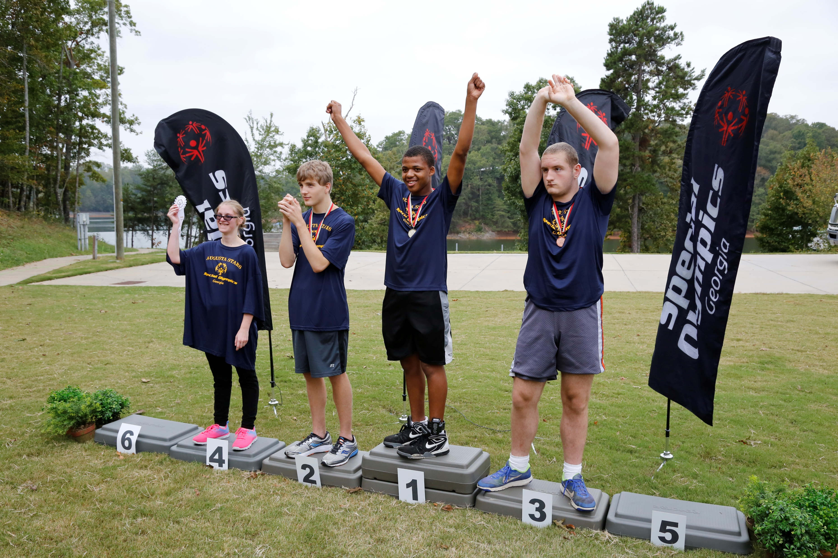
VENUES
Bocce
Cycling
Golf
Softball Skills
Softball Team
Olympic Town
Opening Ceremony & Dance

Slide 5
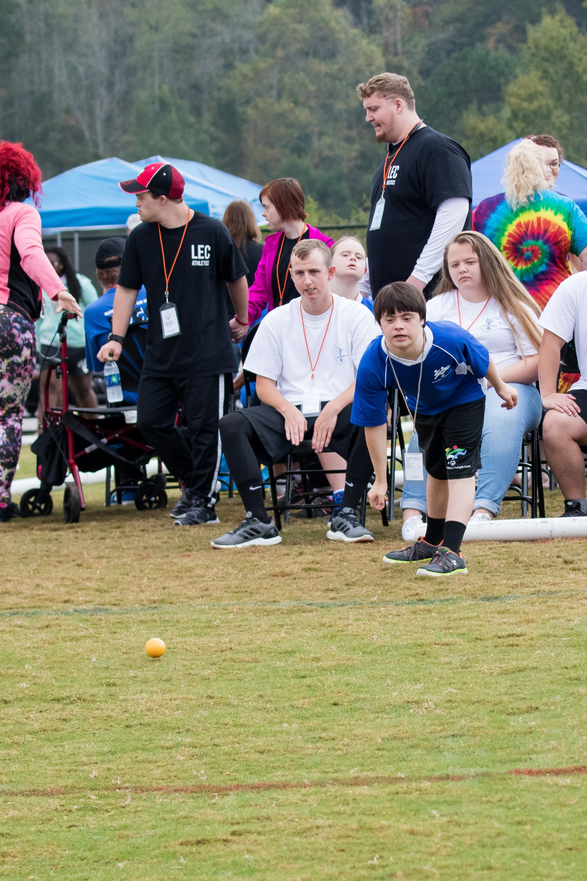
WHAT IS BOCCE?
Bocce is a “closest to” type sport that consists of two opposing teams throwing 4 balls each with the teams competing to get their balls closest to the pallina. Points are given for each ball that is closer to the pallina – a bocce official determines points given.
Bocce is divided into traditional (all Special Olympics athletes) and unified (Special Olympic athletes and non athletes) teams.
There are a total of 22 bocce courts with 2 opposing teams (consisting of 4 players per team) competing per court.
Each court has one bocce official who determines the “official” score.
The official will go over the rules and regulations and will give each volunteer instructions on his or her responsibilities.

Slide 6
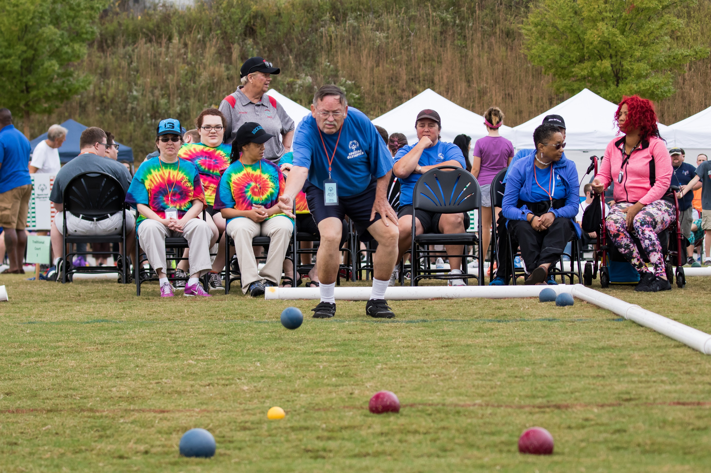
BOCCE VOLUNTEER POSITIONS
Score – volunteer keeps a tally of points for both teams
Score keeper – using the official score sheet volunteers log final team scores and has the Captain of each team sign the score sheet. Sheets are then given to the bocce venue director or taken to check in table.
Measurer – measures the distance of bocce balls using the official SOGA measuring tape.
Ball retriever – volunteer returns balls to original end of the court.
Escort – escorts athletes to and from bocce courts.
Awards – assist with the presentation of medals and ribbons, announces winners, escorts athletes from bocce courts to awards area, assist athletes into position.

Slide 7
CYCLING VOLUNTEER POSITIONS
Athlete check in – Check in athletes as they arrive. Verify their placement and numbers.
Staging area - Call next group of competitors to staging area. Verify riders, bikes, and safety.
Starters - Verify riders on heat sheet. Ensure timers are ready and shoot the gun to begin.
Timers – Timers will be assigned to each athlete competing and calls out the times that their athlete crosses finish line to recorder.
Time recorder - Records times called out to them from timers as athletes cross the finish line.
Number recorder - Records number of athlete, in order of finish.
Compiler - Takes data from Time and Number Recorders and combines information.
Race course volunteers – Stationed at various spots along the race course to ensure rider safety and to encourage riders as they compete.
Riders – Rides with athletes along the route to ensure rider safety.
Awards – assist with the presentation of medals and ribbons, announces winners, escorts athletes from bocce courts to awards area, assist athletes into position.

Slide 8
GOLF VOLUNTEER POSITIONS
Athlete check in – check in athletes as they arrive.
Scorekeepers – Volunteers will be stationed at various golf skills locations to keep score.
Escorts – Volunteers will escort athletes to correct locations and keep track of athletes as they compete.
Ball Retriever – Volunteer retrieves golf balls.
Monitors (for Iron Shot competition during golf skills) – Volunteers stationed along the boundaries of the grid on the driving range and identify where balls land and relay score to scorer.
Golf cart – Drives golf cart to monitor athletes.
Athlete cart driver - Assigned to drive a cart, or accompany each foursome in a separate cart to monitor play/scores. These volunteers should be golf knowledgeable.
Drink cart - Volunteer drives refreshment/drink cart around golf course to see if athletes need water. Also, checks each water station located around the golf course and refills as needed.
Awards – assist with the presentation of medals and ribbons, announces winners, escorts athletes from bocce courts to awards area, assist athletes into position.

Slide 9
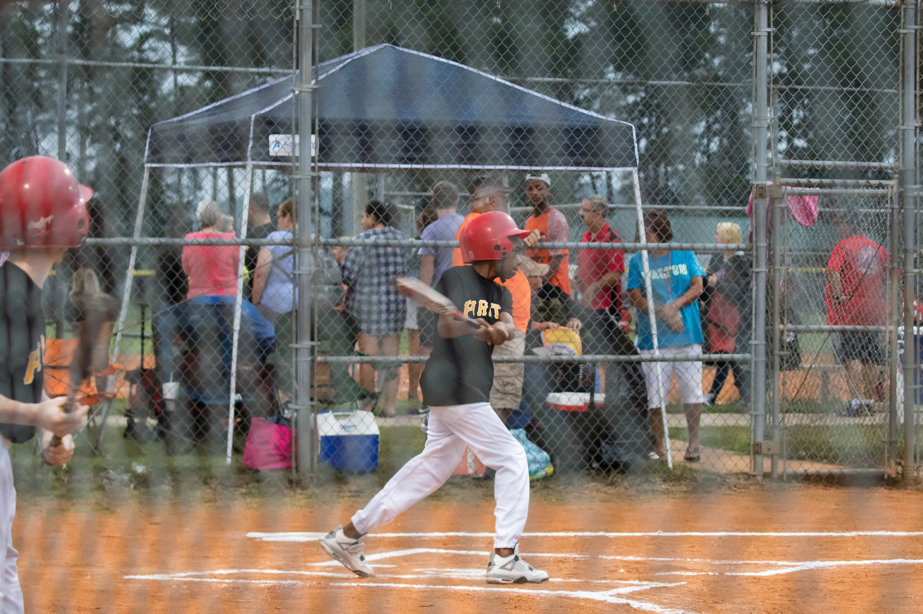
SOFTBALL SKILLS VOLUNTEER POSITIONS
Athlete check in – Check in athletes as they arrive.
Timer – Keeps time for each event.
Score keeper – Keeps score for each event.
Overall score keeper – Records the final overall scores for each event.
Ball chaser – Retrieves softballs
Water stations - Volunteers will help with any water needs at the venue.
Awards – assist with the presentation of medals and ribbons, announces winners, escorts athletes from bocce courts to awards area, assist athletes into position.

Slide 10
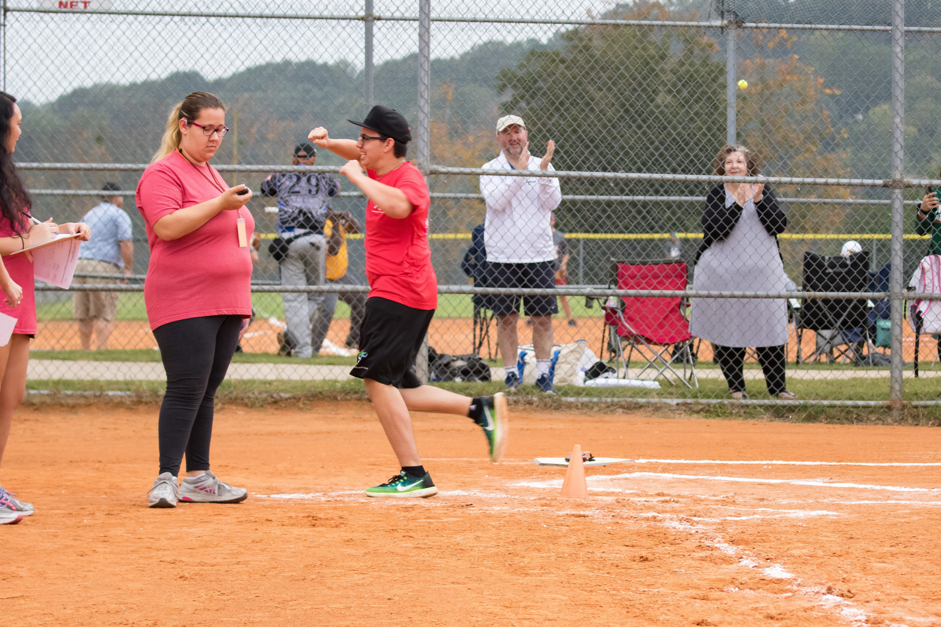
SOFTBALL TEAM VOLUNTEER POSITIONS
Athlete check in – Check in athletes as they arrive.
Scoreboard – Runs the scoreboard clock and keeps score on scoreboard.
Score keeper – Keeps score for each event.
Ball chaser – Retrieves softballs
Water stations - Volunteers will help with any water needs at the venue.
Awards – assist with the presentation of medals and ribbons, announces winners, escorts athletes from bocce courts to awards area, assist athletes into position.

Slide 11
OLYMPIC TOWN VOLUNTEER POSITIONS
Olympic Town is a carnival like atmosphere that athletes can participate in when they are not competing. It will take place on Saturday
Booth volunteers – assist athletes with games, super slide, and crafts
Food and Drinks – hand out water, soda, popcorn to athletes

Slide 12
OEPNING CEREMONY & DANCE VOLUNTEER POSITIONS
Friday Evening
Volunteers:
Hand out program books
Organize the athlete parade line up
Escort attendees, greet athletes
Block aisles for the torch run
Hand out refreshments during dance
Crowd control during dance
Clean Up – chairs, tables, trash

Slide 13
EXPECTATIONS WHILE WORKING WITH ATHLETES
One of the biggest questions that new volunteers have is how to work with our athletes. If you are a new volunteer, here a few things to keep in mind:
Special Olympics offers competitions to children AND adults, so don’t assume that an athlete is a child. Make sure to talk to athletes like adults and with respect.
Many athletes like to hug, shake hands, give high fines, etc. You may reciprocate if the athlete initiates it and you are comfortable with that.
Some athletes are in wheelchairs – do not lean on their chairs.
Some athletes have speech impediments. If you cannot understand an athlete, ask them to repeat themselves or ask a coach or one of the athlete’s teammates to help you to understand.
There are some athletes that salivate excessively, are very stiff, or have other symptoms associated with their disability. Please do not stare.
Remember that respect of the dignity and effort of the athletes is the priority at Special Olympics. Pity is not part of the game.

Slide 14
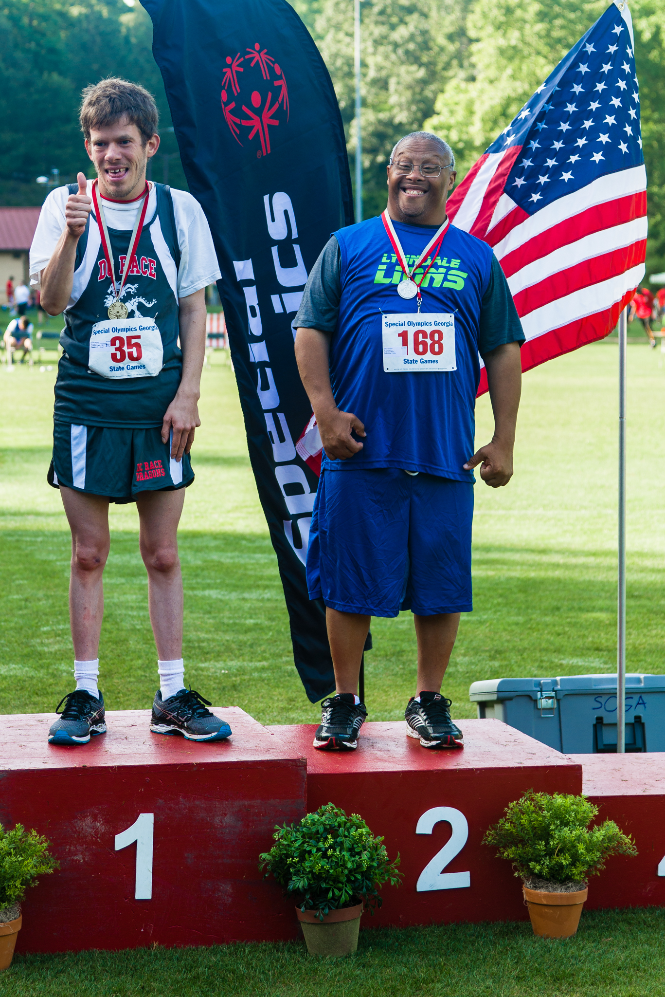
GENERAL GUIDELINES VOLUNTEER BEHAVIOR
Volunteers may hug an athlete only when the athlete initiates the hug
Volunteers should not disrupt competitions in any way
Volunteers should encourage, not coach, the athletes
Volunteers should be friendly, not threatening or harassing to other volunteers or staff
All equipment, banners, t-shirts, and other materials used during competition is the property of SOGA or participating agencies. Please do not take any of these items including the blue volunteer bibs, which must be returned to volunteer registration when you have completed your assignment.
A situation may arise that causes a delay in competition. Please be patient and understand that the SOGA staff is doing all they can to resolve any issues so that competition can continue. During any downtime, get to know the athletes.
And above all else, HAVE FUN!

Slide 15
VOLUNTEER REGISTRATION
Make sure to sign in at the volunteer registration table
BRING ID
You will receive a volunteer lanyard and nametag. Please return your lanyard to the table after your shift
You will then be directed to your venue. Make sure to check-in with your volunteer coordinator when you arrive
Any questions, find your volunteer coordinator or a SOGA staff person

Slide 16
THINGS TO REMEMBER
Make sure to arrive at your venue on time! Be sure to provide yourself time to get parked, checked in, etc. There will be instructions given for each position and if you are not present in time, you will miss your placement. Competitions WILL start on time and all volunteers will be assigned before competition starts. If you are not present when instructions are given and volunteers are assigned, there may not be a volunteer spot for you.
Food is not provided for volunteers so please remember to eat before or after your shift. You are welcome to bring a snack with you but you cannot stop to eat during your shift unless there is a break.
Water will be available at all venues.

Slide 17
THINGS TO REMEMBER CONT’D
You are responsible for your personal possessions.
Check weather reports and dress appropriately & comfortably (t-shirt, tennis shoes, etc.)
Competition goes on rain or shine so please plan on volunteering even if it rains. In cases of extreme weather, competitions may be delayed slightly or moved to a new location (you will be notified if competition has been moved).
Make sure to stay for your ENTIRE shift. Interruptions can cause major delays in competition. You are a vital part of how well the competitions run.

Slide 18
THANK YOU SO MUCH FOR VOLUNTEERING AT OUR STATE FALL GAMES!! WE WOULD NOT BE ABLE TO PROVIDE QUALITY EVENTS FOR OUR ATHLETES IF IT WASN’T FOR YOU!
For questions or concerns, please contact
Paul McNeil, Volunteer and Event Manager
770-414-9390 ext. 1116
BE A FAN. BRING OUT THE CHAMPION IN EVERYONE..

