Slide 1
SPECIAL OLYMPICS GEORGIA VOLUNTEER ORIENTATION
STATE SUMMER GAMES

Slide 2
OUR MISSION
To provide year-round sports training and athletic competition in a variety of Olympic-type sports for all children and adults with intellectual disabilities, giving them continuing opportunities to develop physical fitness, demonstrate courage, experience joy, and participate in the sharing of gifts, skills, and friendship with their families, other Special Olympic athletes, and the community.

Slide 3
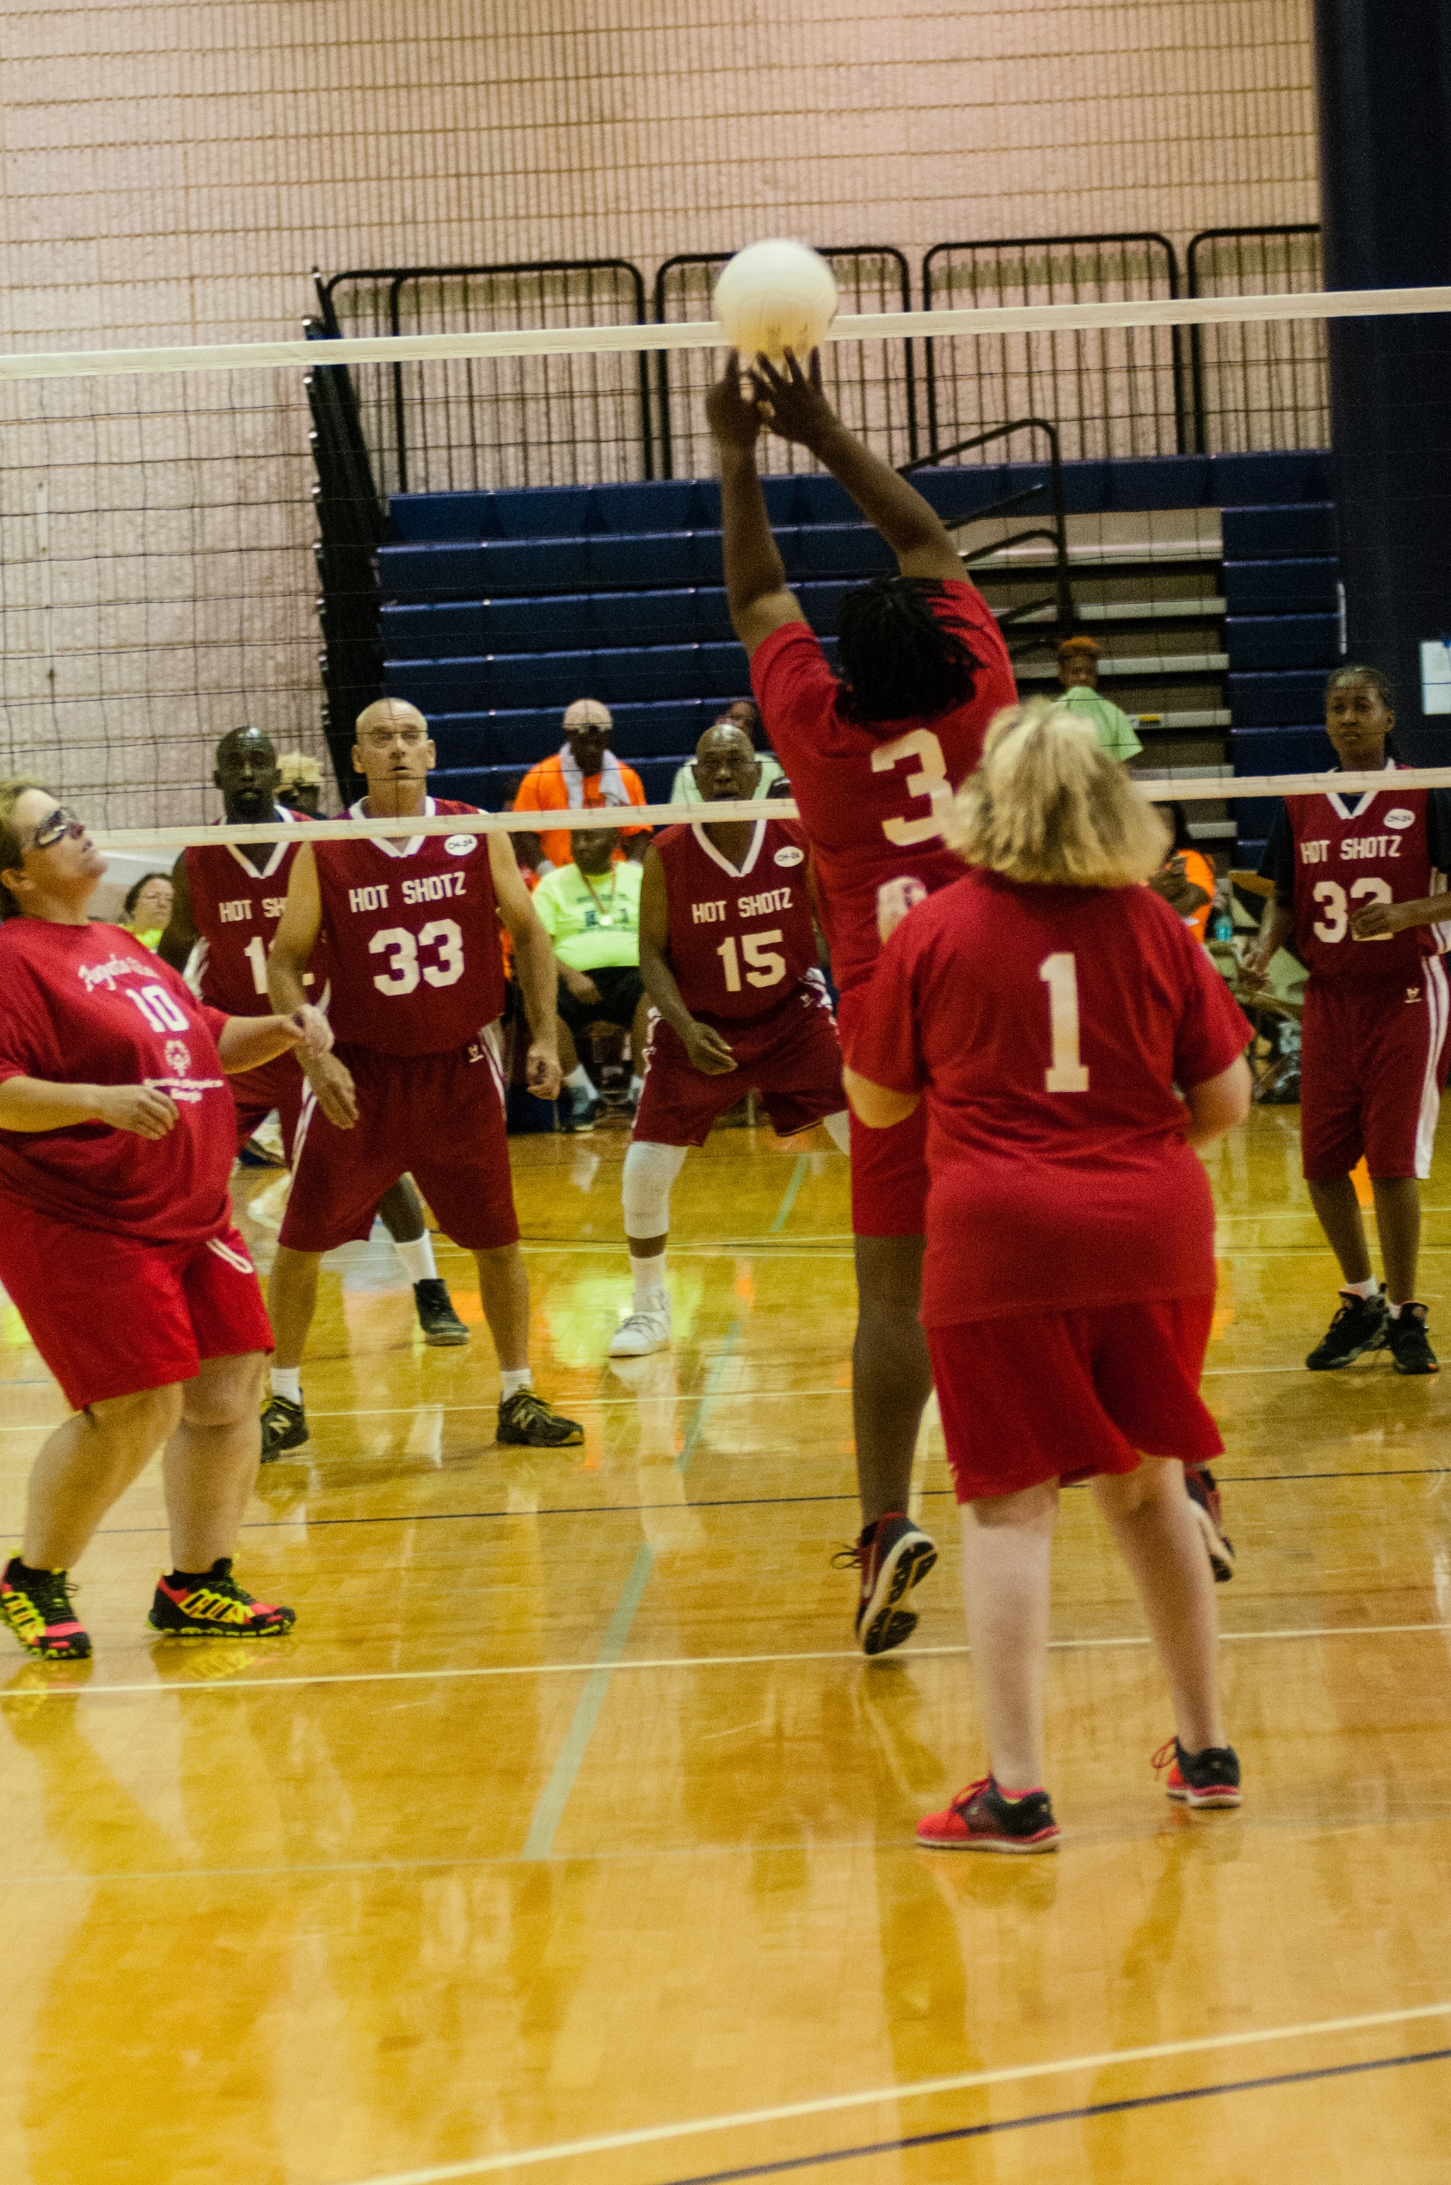
STATE SUMMER GAMES
Nearly 2,000 athletes from around the state compete in aquatics, athletics, flag football, gymnastics, soccer, table tennis, tennis and volleyball with over 500 coaches to guide them in competition.
Over 1,500 volunteers will be on hand the weekend of the games.
Competition begins on Friday and ends Sunday with the Opening Ceremony Friday evening and Victory Dance immediately following the Ceremonies.

Slide 4
VENUES
Aquatics
Athletics (Track and Field & Long Distance Running/Walking)
Flag Football
Rhythmic Gymnastics
Soccer
Table Tennis
Tennis
Volleyball
Olympic Town
Opening Ceremony & Dance

Slide 5
AQUATICS VOLUNTEER POSITIONS
Athlete check in – Check in athletes as they arrive. Verify their placement and numbers.
Bull pen assistants - Keep athletes on task and assist in calling the next round of athletes to competition.
Timers - keep time for the athletes during competition.
Escorts - assist athletes in WALKING around the pool to their correct lane.
Announcers – announces athlete names, heats, and awards
Awards – assist with the presentation of medals and ribbons, announces winners, escorts athletes to awards area, assist athletes into position.
Fans in the Stands – cheers for and encourages
athletes as they compete.
Can make signs or use shakers when available.

Slide 6
ATHLETICS VOLUNTEER POSITIONS
Athlete check in – Check in athletes as they arrive. Verify their placement and numbers.
Heat tables - keep athletes on task; assist in calling the next round of athletes to competition.
Heat tents - receive athletes preparing for competition and keep athletes on task and ready to compete.
Escorts - assist athletes in WALKING around track and arriving to the correct event location.
Timers - keep time for the athletes.

Slide 7
ATHLETICS VOLUNTEER POSITIONS (CONT’D)
Runners - run times and scores to appropriate volunteers.
Pick up tents - receive athletes after their competition and congratulate and wait for their coaches to pick them up.
Station volunteers – assist athletes and officials and various stations including long jump, shot put, and softball throw.
Awards – assist with the presentation of medals and ribbons, announces winners, escorts athletes to awards area, assist athletes into position.
Fans in the Stands – cheers for and encourages athletes as they compete. Can make signs or use shakers when available.

Slide 8
SOCCER TEAM VOLUNTEER POSITIONS
Volunteer Registration - Check – in volunteers at venue.
This is technically the 2nd registration; Woodruff PE Center is 1st!
Athlete Check – In - Register athletes / agencies.
Ask Venue Director for exact instructions.
Escorts - Assist athletes in WALKING around the field.
Ball Retrievers - Collect soccer balls as they are kicked off the field!
Runners - Run scores and times to proper volunteers or staff person.
Score Reporters - Report scores to crowd and teams.
Keep Standing - Keep track of teams and their wins / losses.
Monitor Substitutes - Ensure proper number / selection of athletes are playing.
Keep Order - Keep fans in crowd and athletes in correct location.
Water - Make sure water is available.

Slide 9
SOCCER SKILLS VOLUNTEER POSITIONS
Volunteer Registration - Check – in volunteers at venue.
This is technically the 2nd registration; Woodruff PE Center is 1st!
Athlete Check – In - Register athletes / agencies.
Ask Venue Director for exact instructions.
Escorts - Assist athletes in WALKING around the field.
Ball Retrievers - Collect soccer balls as they are kicked off the field!
Runners - Run scores and times to proper volunteers or staff person.
Score Reporters - Report scores to crowd and teams.
Keep Standing - Keep track of teams and their wins / losses.
Monitor Substitutes - Ensure proper number / selection of athletes are playing.
Keep Order - Keep fans in crowd and athletes in correct location.
Water - Make sure water is available.
Conducting Skills: In charge of conducting one of the three skills
Score Reporter: Will be assigned to a division and go through the skills with the athletes and keep score

Slide 10
FLAG FOOTBALL VOLUNTEER POSITIONS
Athlete check in – check in athletes as they arrive. Verify their placement and numbers.
Score keeper – record and tally points by official’s signal.
Timer – keep time of games/control timer on scoreboard.
Ball retrievers – retrieve loose balls on field and assist athletes as needed.
Water station - assist with any water needs at the venue.
Awards – assist with the presentation of medals and ribbons, announces winners, escorts athletes to awards area, assist athletes into position.
Fans in the Stands – cheers for and encourages athletes as they compete. Can make signs or use shakers when available.

Slide 11
GYMNASTICS VOLUNTEER POSITIONS
Athlete check in – check in athletes as they arrive.
Scorekeepers - record the judge’s score on the appropriate sheet and rank the gymnasts according to the scores.
Line judge assistant - inform the head judge when a gymnast steps out of bounds during the floor exercise routine.
Score flasher - flashes the gymnast’s score after performance.
Escort - marches in with the delegation.
Runners - takes scores from the judges table to the scorekeeper’s desk.
Awards – assist with the presentation of medals and ribbons, announces winners, escorts athletes to awards area, assist athletes into position.
Fans in the Stands – cheers for and encourages athletes as they compete. Can make signs or use shakers when available.

Slide 12
TABLE TENNIS VOLUNTEER POSITIONS
Athlete check in – Check in athletes as they arrive.
Ball chasers – retrieve loose balls.
Timers - keep time for the athletes.
Counters - keep track of the score.
Water stations – distribute water to athletes as needed.
Awards – assist with the presentation of medals and ribbons, announces winners, escorts athletes from courts to awards area, assist athletes into position.
Fans in the Stands – cheers for and encourages athletes as they compete. Can make signs or use shakers when available.

Slide 13
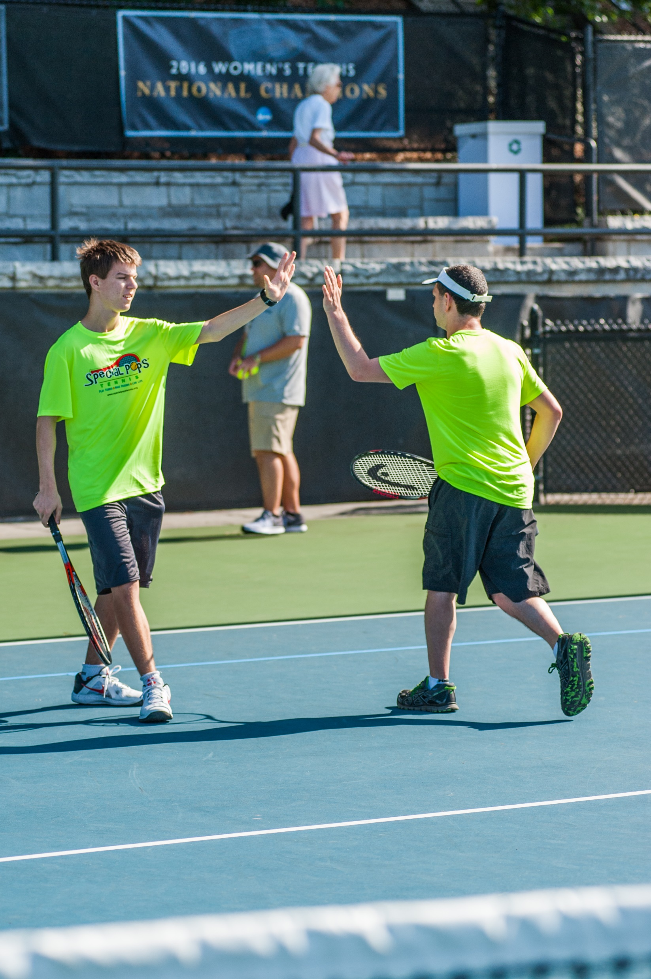
TENNIS VOLUNTEER POSITIONS
Athlete check in – Check in athletes as they arrive.
Ball chasers – retrieve loose balls.
Scorekeepers - keep track of the score.
Escorts – escort athletes to correct courts.
Water stations – distribute water to athletes as needed.
Awards – assist with the presentation of medals and ribbons, announces winners, escorts athletes from courts to awards area, assist athletes into position.

Slide 14
VOLLEYBALL VOLUNTEER POSITIONS
Athlete check in – Check in athletes as they arrive.
Escorts – escort athletes to correct courts.
Scorekeepers – Keep track of the scores for each games while following rules of competition.
Linesmen – you will be given a flag, and then stand on the back of the court, judging in/out of bounds lines watching for foot faults while athletes are serving
Ball chasers – retrieve loose volleyballs during competition
Water stations – distribute water to athletes as needed
Awards – assist with the presentation of medals and ribbons, announces winners, escorts athletes from courts to awards area, assist athletes into position.

Slide 15
OLYMPIC TOWN VOLUNTEER POSITIONS
Olympic Town is a carnival like atmosphere that athletes can participate in when they are not competing. It will take place on Saturday
Booth volunteers – assist athletes with games, super slide, and crafts
Food and Drinks – hand out water, soda, popcorn to athletes

Slide 16
OEPNING CEREMONY & DANCE VOLUNTEER POSITIONS
Friday Evening
Volunteers:
Hand out program books
Organize the athlete parade line up
Escort attendees, greet athletes
Block aisles for the torch run
Hand out refreshments during dance
Crowd control during dance
Clean Up – chairs, tables, trash

Slide 17
EXPECTATIONS WHILE WORKING WITH ATHLETES
One of the biggest questions that new volunteers have is how to work with our athletes. If you are a new volunteer, here a few things to keep in mind:
Special Olympics offers competitions to children AND adults, so don’t assume that an athlete is a child. Make sure to talk to athletes like adults and with respect.
Many athletes like to hug, shake hands, give high fines, etc. You may reciprocate if the athlete initiates it and you are comfortable with that.
Some athletes are in wheelchairs – do not lean on their chairs.
Some athletes have speech impediments. If you cannot understand an athlete, ask them to repeat themselves or ask a coach or one of the athlete’s teammates to help you to understand.
There are some athletes that salivate excessively, are very stiff, or have other symptoms associated with their disability. Please do not stare.
Remember that respect of the dignity and effort of the athletes is the priority at Special Olympics. Pity is not part of the game.

Slide 18
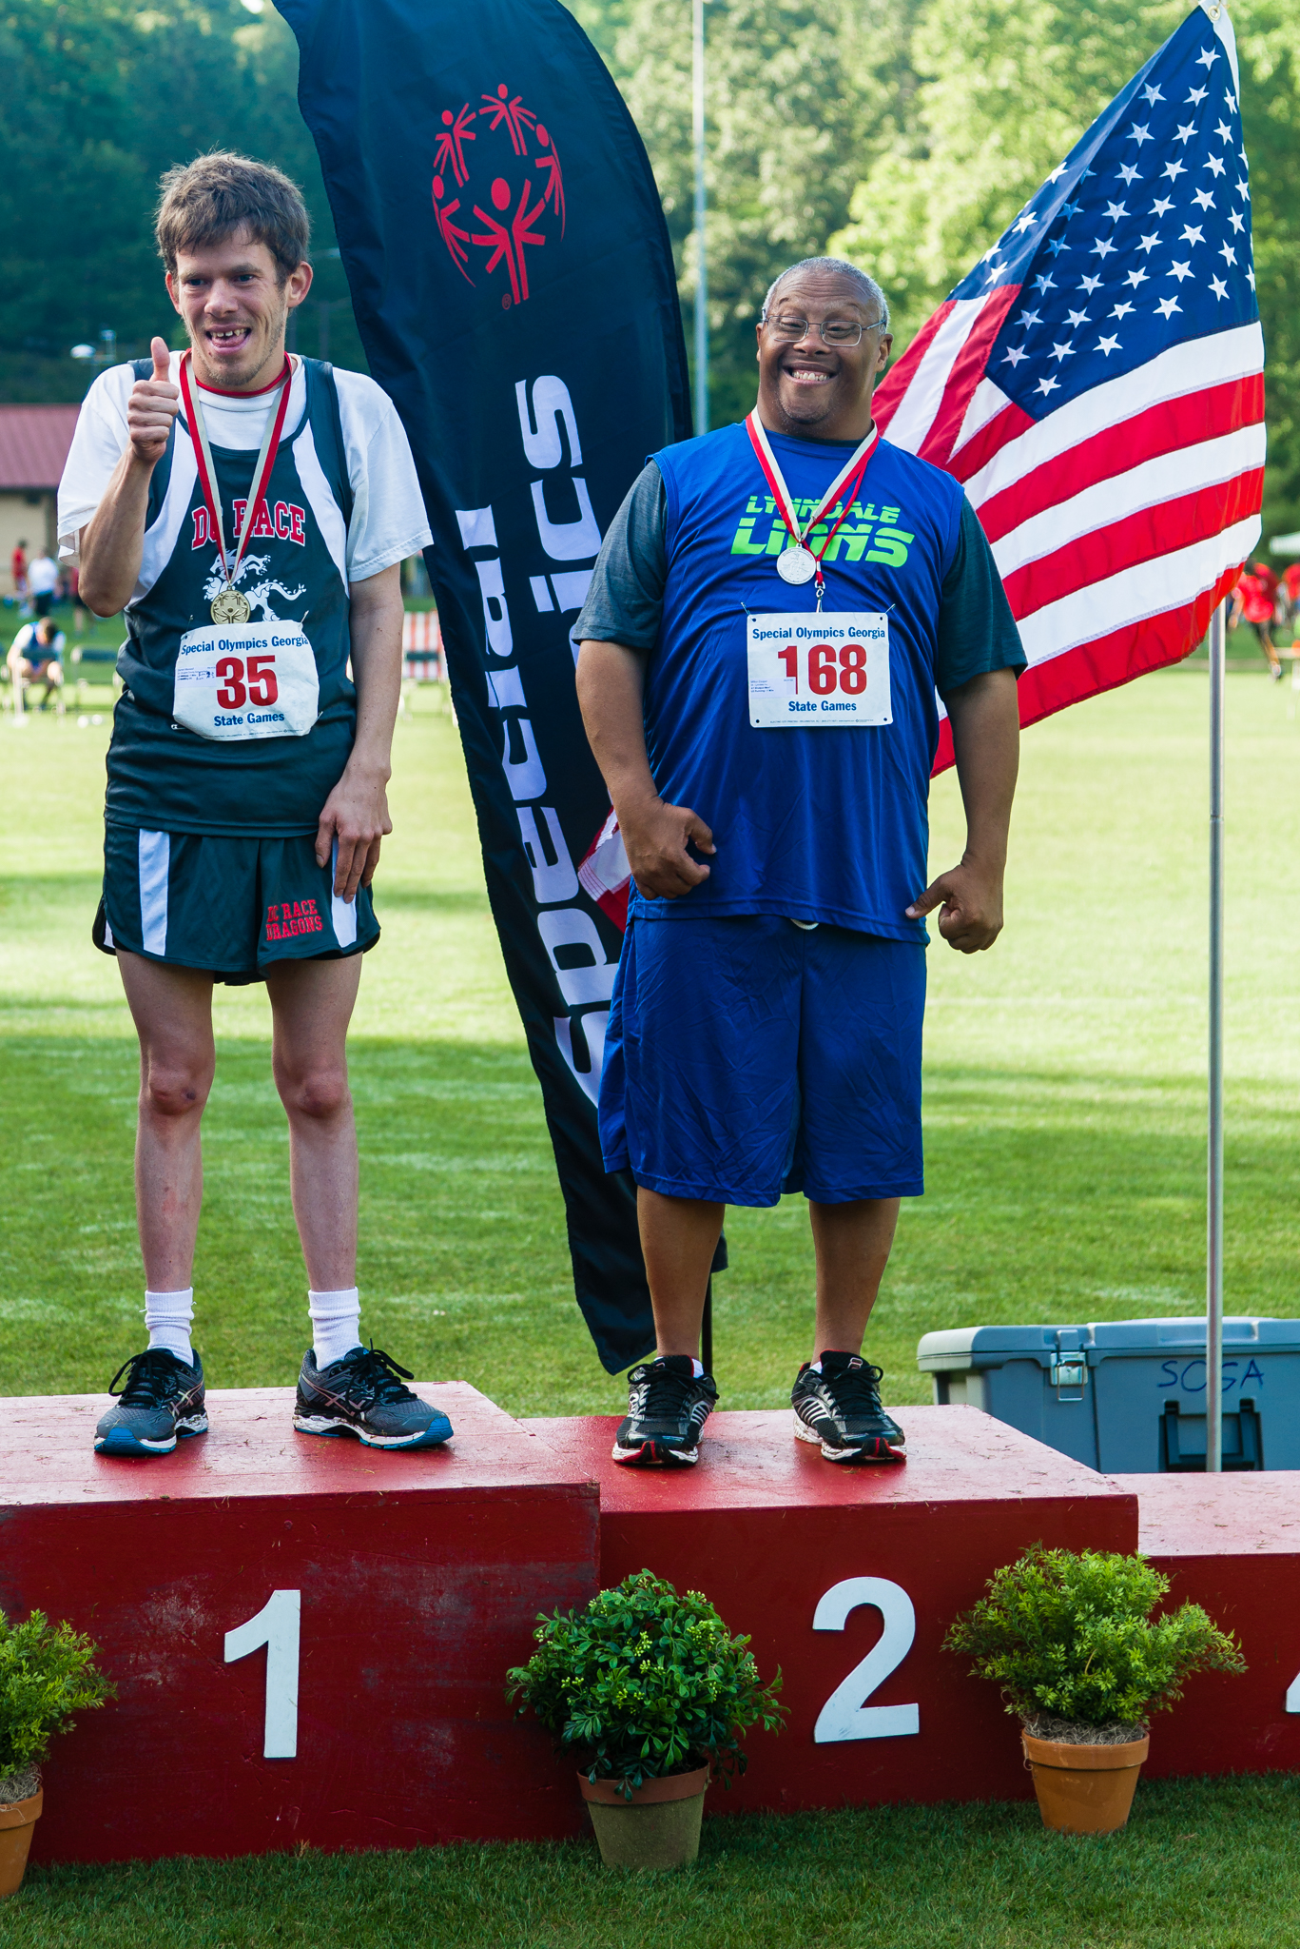
GENERAL GUIDELINES VOLUNTEER BEHAVIOR
Volunteers may hug an athlete only when the athlete initiates the hug
Volunteers should not disrupt competitions in any way
Volunteers should encourage, not coach, the athletes
Volunteers should be friendly, not threatening or harassing to other volunteers or staff
All equipment, banners, t-shirts, and other materials used during competition is the property of SOGA or participating agencies. Please do not take any of these items including the blue volunteer bibs, which must be returned to volunteer registration when you have completed your assignment.
A situation may arise that causes a delay in competition. Please be patient and understand that the SOGA staff is doing all they can to resolve any issues so that competition can continue. During any downtime, get to know the athletes.
And above all else, HAVE FUN!

Slide 19
VOLUNTEER REGISTRATION
When you arrive, please park in the Peavine Parking Deck. (Map of Emory University’s campus on next slide)
Across the street from the parking deck will be the main volunteer registration check-in table outside of the Woodruff PE Center
BRING ID
You will receive a volunteer lanyard and nametag. Please return your lanyard to the table after your shift
You will then participate in a small training, giving direction on positions and placements
Any questions, find your volunteer coordinator or a SOGA staff person

Slide 20
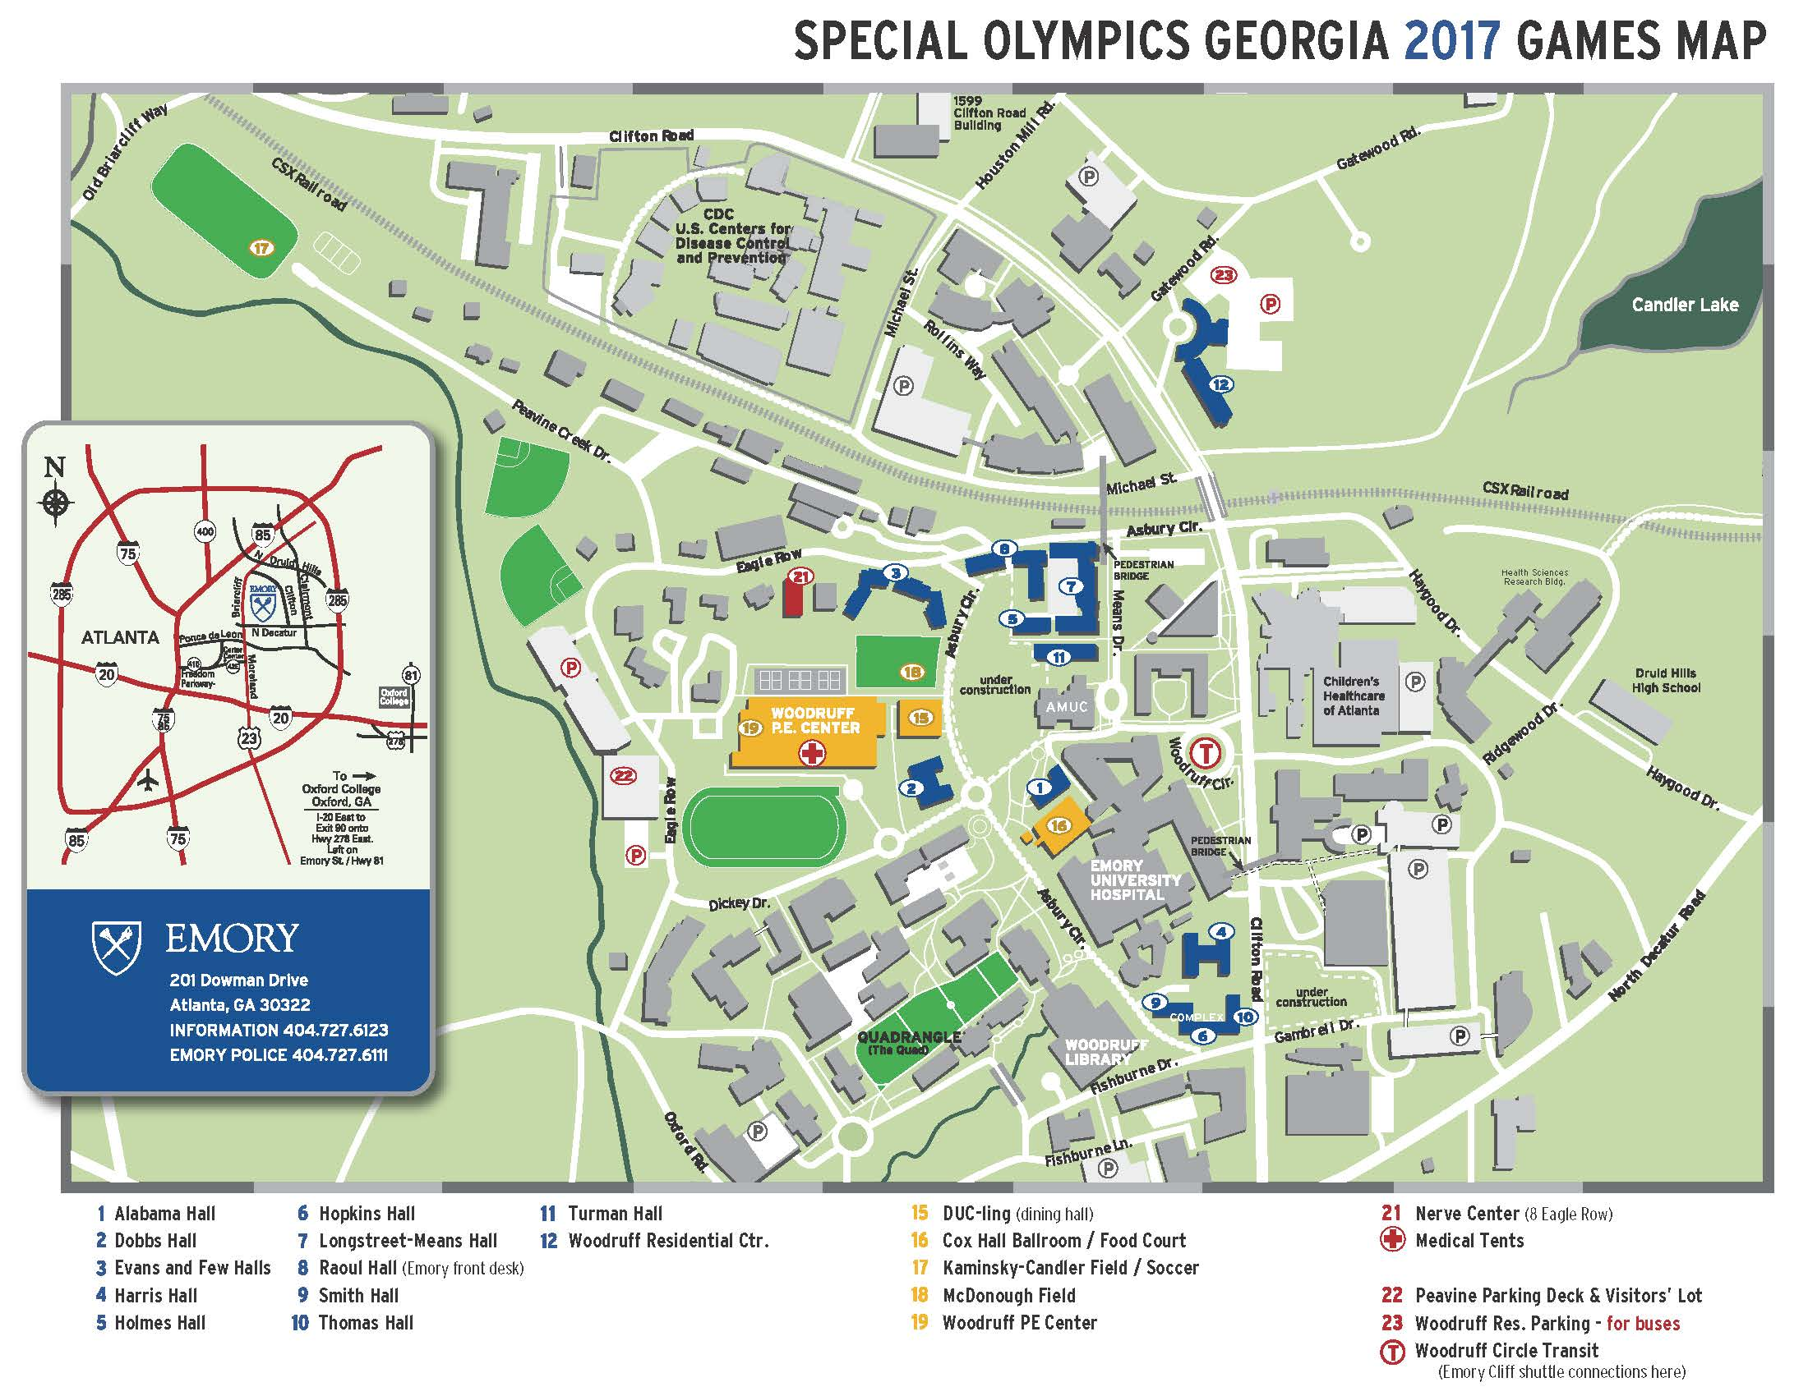

Slide 21
THINGS TO REMEMBER
Make sure to arrive at your venue on time! Be sure to provide yourself time to get parked, checked in, etc. There will be instructions given for each position and if you are not present in time, you will miss your placement. Competitions WILL start on time and all volunteers will be assigned before competition starts. If you are not present when instructions are given and volunteers are assigned, there may not be a volunteer spot for you.
Food is not provided for volunteers so please remember to eat before or after your shift. You are welcome to bring a snack with you but you cannot stop to eat during your shift unless there is a break.
Water will be available at all venues.

Slide 22
THINGS TO REMEMBER CONT’D
You are responsible for your personal possessions.
Check weather reports and dress appropriately & comfortably (t-shirt, tennis shoes, etc.)
Competition goes on rain or shine so please plan on volunteering even if it rains. In cases of extreme weather, competitions may be delayed slightly or moved to a new location (you will be notified if competition has been moved).
Make sure to stay for your ENTIRE shift. Interruptions can cause major delays in competition. You are a vital part of how well the competitions run.

Slide 23
THANK YOU SO MUCH FOR VOLUNTEERING AT OUR STATE SUMMER GAMES!! WE WOULD NOT BE ABLE TO PROVIDE QUALITY EVENTS FOR OUR ATHLETES IF IT WASN’T FOR YOU!
For questions or concerns, please contact
Liz Smith, Volunteer and Event Manager
229-712-9973
BE A FAN. BRING OUT THE CHAMPION IN EVERYONE..

