Slide 1
SPECIAL OLYMPICS GEORGIA GENERAL ORIENTATION
PLEASE USE THIS DOCUMENT WHEN TAKING THE GENERAL ORIENTATION TEST ON OUR WEBSITE

Slide 2
Objectives and Competencies
Describe Special Olympics mission and philosophy.
Briefly describe the history of Special Olympics.
Summarize the basic organizational structure of Special Olympics – grassroots to headquarters.
Identify eligibility requirements and access into Special Olympics.
Describe what opportunities in Special Olympics are available to volunteers.

Slide 3
Objectives and Competencies
Identify Special Olympics sports and events.
Identify how Special Olympics is unique from other sports organizations.
Describe Special Olympics rules, ability grouping, honest effort, and divisioning.
Describe available Special Olympics program offerings, challenges, and benefits to athletes.
List the steps taken if suspect an athlete is being abused or neglected.

Slide 4
I. Overview of the Organization A. Special Olympics Mission & Philosophy; Vision; Athlete's Oath; Coaches Oath
Mission: To Provide year-round sports training and athletic competition in a variety of Olympic-type sports for children and adults with intellectual disabilities or closely related developmental disabilities, giving them continuing opportunities to develop physical fitness, demonstrate courage, experience joy and participate in a sharing of gifts, skills and friendship with their families, other Special Olympics athletes and the community.
Why is following the mission important?
We are sanctioned by the International Olympic Committee (IOC) and must follow their guidelines (they are our NGB)
Only 3 groups were sanctioned to use “Olympics”
Jr. Olympics
Paralympics
Special Olympics
Senior Games tried but was denied

Slide 5
I. Overview of the Organization A. Special Olympics Mission & Philosophy; Vision; Athlete's Oath; Coaches Oath
Philosophy:
Special Olympics is founded on the belief that people with intellectual disabilities can, with proper instruction and encouragement, learn, enjoy and benefit from participation in individual and team sports.
Special Olympics believes that consistent training is essential to the development of sports skills, and that competition among those of equal abilities is the most appropriate means of testing these skills, measuring progress and providing incentives for personal growth.
Special Olympics believes that through sports training and competition, people with intellectual disabilities benefit physically, mentally, socially, and spiritually; families are strengthened; and the community at large, both through participation and observation, is united in understanding people with intellectual disabilities in an environment of equality, respect and acceptance.

Slide 6
I. Overview of the Organization A. Special Olympics Mission & Philosophy; Vision; Athlete's Oath; Coaches Oath
Vision:
The vision of Special Olympics is to help bring Special Olympics athletes into the larger society under conditions whereby they are accepted, respected and given the chance to become useful and productive citizens.
Athlete’s Oath:
“Let me win, but if I cannot win, let me be brave in the attempt.”
Coaches Oath:
“In the name of all coaches, we shall follow written and verbal instructions of Special Olympics officials at all times, have our athletes at the appropriate events and activities at the proper time and abide by the rules and policies, in the spirit of sportsmanship.”

Slide 7
I. Overview of the Organization B. History
Created by Eunice Kennedy Shriver in 1968
First International (now called World) Games held in July 1968 at Soldier Field in Chicago with 1000 athletes with intellectual disabilities from 26 U.S. states and Canada competing in Athletics, Floor Hockey, and Aquatics.
In 1971, the U.S. Olympic Committee gave Special Olympics official approval to use the name “Olympics”, one of only three global organizations. (Junior Olympics, Paralympics, and Special Olympics).
In March 2019, World Games were held in Abu Dhabi, United Arab Emirates with over 7,500 athletes with intellectual disabilities from 200 countries competing in 24 sports.

Slide 8
I. Overview of the Organization B. History
Special Olympics Georgia (SOGA) was chartered in 1970.
Special Olympics Georgia is:
One of the largest volunteer driven sports organizations in the state
One of the largest Special Olympics program in North America –
40,000 + Volunteers
17,000 Athletes
Offers 26 Olympic – type sports year round
Offers 4 Statewide Competitions throughout the year with over 600 local and area competitions offered.
Indoor Winter Games – January
Summer Games – May
Horse Show – May
Fall Games – October

Slide 9
I. Overview of the Organization C. Structure
Special Olympics, Inc. (SOI)
The World governing body of Special Olympics
Based in Washington, DC – staffed by approximately 100 individuals
Responsible for accrediting Programs worldwide
Special Olympics North America (SONA)
Oversees the management of all USA Games and Coaching Education
Provides support and collaboration in the development of materials, conferences, and regional instructor training seminars
Special Olympics Georgia (SOGA)
Oversees the management of all Georgia programs

Slide 10
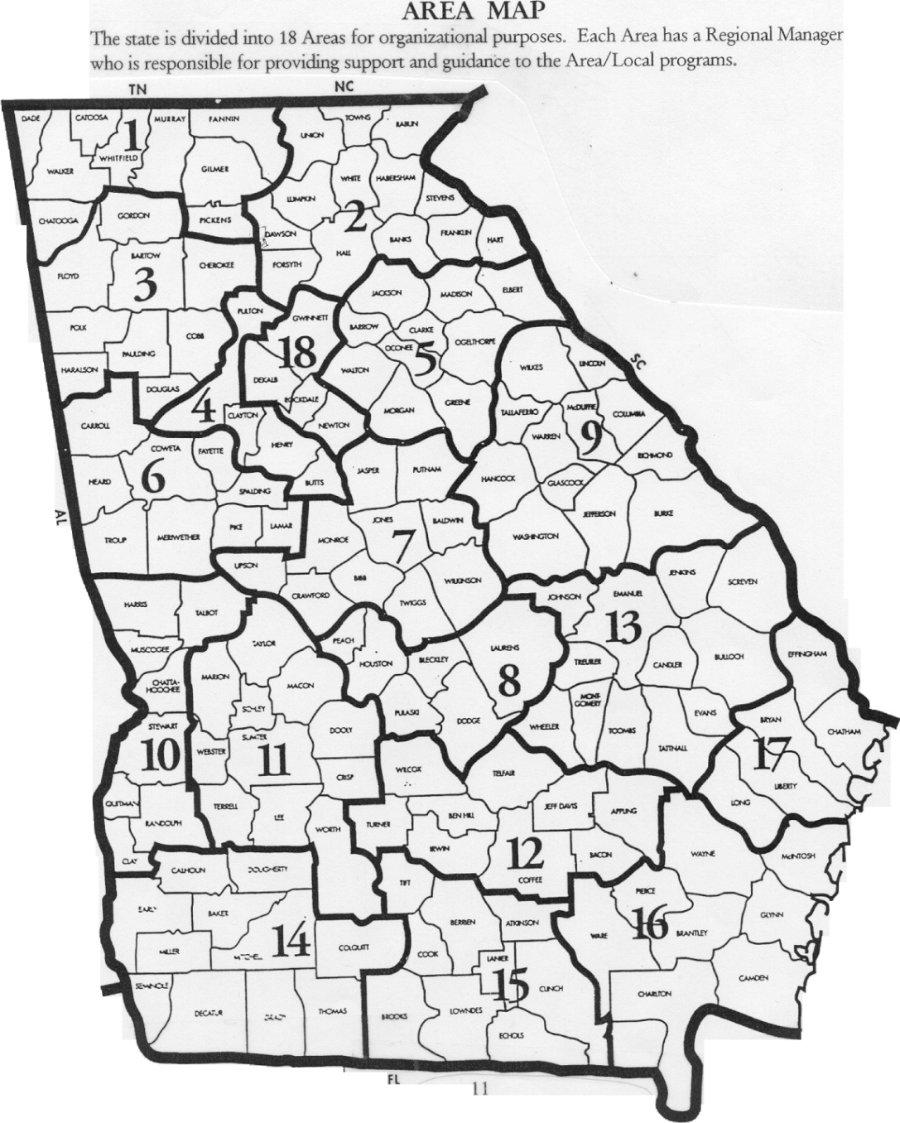
SOGA Map of Georgia Counties and Assigned Areas Program Services Team: Sarah Galbraith: (Area’s 2, 18) Program & Event Manager Jordan Davis: (Area’s 1, 3, 6) Program Manager Hannah Creasey: (Area’s 5, 9) Volunteer & Program Manager Liz Smith: (Area 4) Director of Program Services Stephanie Bailey : (Area 10) Unified Champion Schools Program Manager TBD: (Area’s 12, 14) Senior Volunteer and Program Manager Meredith Elizabeth Crum: (Area’s 7, 8, 11) Program Manager Skylar Lunsford: (Area’s 13, 16, 17) Program Manager David Crawford: (Area 15) Chief Sports & Programs Officer

Slide 11
I. Overview of the Organization D. Roles for the Special Olympics Volunteer
Special Olympics would not exist today – and could not have been created – without the time, energy, commitment and enthusiasm of the more than 500,000 Special Olympics volunteers.
Volunteers ensure that every athlete is offered a quality sports training and competition experience.
Our volunteer pool is dedicated and diverse. Volunteers include: civic and fraternal groups, high school and college students, amateur and professional athletes, sports officials, coaches, teachers, retirees, parents, and corporate employees.
There are a variety of important volunteer roles, from a chaperone at an event to an Area / Local Management Team member, to a Games Organizing Committee member, to a member of the Board of Directors.

Slide 12
I. Overview of the Organization D. Roles for the Special Olympics Volunteer
Volunteers serve as coaches, officials, games directors, Local Coordinators, local training directors, rules committees, medical personnel during games, Unified Sports partners, fundraisers, publicists or office support.
Family members of Special Olympics athletes play a key role:
Over 25% of certified Special Olympics coaches are family members.
Family members provide day-to-day support through transportation, reinforcement of coach’s instructions, service on local program committees and in many other ways.
Family members recruit family members of new athletes to participate and support the program.

Slide 13
I. Overview of the Organization D. Roles for the Special Olympics Volunteer
Athletes can also volunteer for a wide variety of things within the local and state structure. SOGA has athletes serving:
On the State Board of Directors
On teams as assistant coaches
As Global Messengers
On Area / Local Management Teams

Slide 14
II. Special Olympics Participants A. Traditional Eligibility
Athletes must be 8 years old or older
Athletes must be identified as having intellectual disabilities by an agency or professional
Athletes must have a closely related developmental disability
Athletes must have an Athlete Participation Form on file with the state office

Slide 15
II. Special Olympics Participants A. Traditional Eligibility
Special Olympics training and competition is open to every person who:
1. Has been identified by an agency or professional as having intellectual disabilities, or
2. Has a cognitive delay, as determined by standardized measures, or
3. Has a closely related developmental disability, which means having functional limitations in both general learning and in adaptive skills (such as in recreation, work, independent living, self-direction, or self-care).
Persons whose functional limitations are based solely on physical, behavioral, or emotional disability or a specific learning or sensory disability are not eligible to participate as Special Olympics athletes. However, these individuals may be eligible to be Special Olympics Unified Sports® Partners.

Slide 16
II. Special Olympics Participants A. Traditional Eligibility
Training and competition is open to all persons with intellectual disability, a cognitive delay or a closely related developmental disability who meet the age requirements regardless of how mild or severe the person’s disability, and whether or not that person also has other mental or physical disabilities.
No maximum age limitation for participation.
Children 2-7 years of age may participate in the Young Athletes Program but may not participate in Special Olympics competition or be awarded medals or ribbons associated with competition. Such children may be recognized for their participation through certificates of participation.
All persons who are eligible to participate in Special Olympics training and / or competition programs must register to participate with their local Accredited Program.

Slide 17
II. Special Olympics Participants B. Participation of Individuals with Special Considerations
Down Syndrome and Atlanto-Axial Instability
10% of individuals with Down Syndrome have a misalignment of the cervical vertebrae C-1 and C-2 in the neck. This condition called atlanto-axial instability exposes individuals with Down Syndrome to the possibility of injury if they participate in activities that hyperextend or radically flex the neck or upper spine.
There are temporary restrictions of athletes with Down Syndrome who have atlanto-axial instability.
Prohibited activities include: butterfly stroke and diving starts in swimming, diving, pentathlon, high jump, squat lifts, equestrian sports, artistic gymnastics, soccer, alpine skiing, and any warm-up exercise placing undue stress on the head and neck.

Slide 18
II. Special Olympics Participants B. Participation of Individuals with Special Considerations
Down Syndrome and Atlanto-Axial Instability
An athlete with Down Syndrome who has been diagnosed by a physician as having an atlanto-axial instability condition may nevertheless participate in the sports identified if:
The athlete (or the parent if the athlete is a minor) confirms in writing his or her decision to proceed with these activities notwithstanding the risks created by the atlanto-axial instability;
Two licensed medical professionals certify in writing that they have explained these risks to the athlete and his / her parent or guardian and that the athlete’s condition does not, in their judgment, preclude the athlete from participating in Special Olympics;
The statements and certifications are documented and provided to Accredited Programs using the standardized form approved by Special Olympics headquarters entitled “Special Release for Athletes with Atlanto-axial Instability” and any revisions of that form, approved by Special Olympics headquarters (“Special Release Concerning Atlanto-axial Instability”).

Slide 19
III. Sports Training and Competition A. Uniqueness from Other Sports Organizations
Special Olympics is more similar than different from other sports organizations. However, it is important to identify the five areas that make Special Olympics unique. Per official Special Olympics General Rules:
A variety of sports opportunities are provided for all ability levels.
Ability groupings are created through a process called divisioning to provide equitable competition (evenness) for all athletes within each ability grouping (division).
Awards are provided to all participants who compete.
The established criteria for athlete advancement to higher levels of competition is based on order of finish for each division and random draw.
Special Olympics does not charge a fee to athletes (or their families) to train or compete.

Slide 20
III. Sports Training and Competition B. Competition Opportunities for All Levels
Special Olympics provides a variety of competition opportunities for athletes of all abilities by offering official events or various degrees of difficulty and challenge.
The lowest ability athletes can participate in specially modified events such as:
The 25m Assisted Walk (Athletics) or the 15m Flotation Race (Aquatics)
Events for athletes who use wheelchairs
The Motor Activities Training Program (MATP) provides participation for those requiring the greatest assistance and support
In team sports, lower-ability athletes who are not yet ready for team play, can participate in Individual Skills Contests. For example, in soccer, athletes can earn medals for performing the skills of Dribbling, Shooting, and Run-and-Kick event. Lower ability athletes may also participate in modified team events such as 3-on-3 basketball or modified softball team play.
Most Special Olympics events have few differences from the sport played by individuals without disabilities. Higher ability athletes are now participating in events like the marathon, or in Unified Sports® events alongside athletes without disabilities.

Slide 21
III. Sports Training and Competition C. Unified Sports®
An initiative that combines approximately equal numbers of Special Olympics athletes and athletes without intellectual disabilities (called Unified Partners) with like abilities on sports teams for training and competition.
Age and ability matching of athletes and partners is defined on a sport-by-sport basis.
Unified Sports® athletes improve their physical fitness, sharpen their skills, challenge the competition and have fun, too.

Slide 22
III. Sports Training and Competition C. Unified Sports®
Unified Sports® enables athletes to:
learn new sports; develop higher-level sports skills
have new competition experiences
experience meaningful inclusion as each athlete is ensured of playing a valued role on the team
socialize with peers and form friendships (the initiative provides a forum for positive social interaction between teammates and often leads to long-lasting friendships)
participate in their communities and have choices outside of Special Olympics

Slide 23
III. Sports Training and Competition D. Fitness
Physical fitness is a key part of the Special Olympics mission. Fitness is the state of optimal health and performance through adequate physical activity, nutrition, and hydration. In order for our athletes to be fit, they must practice healthy habits year-round and lifelong. Fitness programming empowers athletes and their supporters to take charge of their own health and fitness by providing necessary education, social support, opportunities and tracking of progress.
Fitness is optimal health and performance through adequate physical activity, nutrition, and hydration and utilized in the Fit 5 program.
Endurance, strength, flexibility, balance are key elements on improvement of Fitness

Slide 24
III. Sports Training and Competition E. Official Sports
Georgia offers 26 sports
Alpine Skiing
Artistic Gymnastics
Athletics
Badminton
Basketball
Bocce
Bowling
Cycling
Equestrian
Flag Football
Floor Hockey
Golf
Ice Speed Skating
SOI offers these 9 additional sports
Cricket
Cross Country Skiing
Floorball
Handball
Judo
Netball
Snowshoeing
Competitive Cheer
Dance Sport
Kayaking
Ice Figure Skating
Powerlifting
Rhythmic Gymnastics
Roller Skating
Sailing
Soccer
Softball
Snowboarding
Swimming
Table Tennis
Tennis
Volleyball

Slide 25
III. Sports Training and Competition F. Divisioning
Divisions provide all competitors a chance to excel.
Competition is organized so that, whenever possible, athletes compete against others of similar ability.
Athletes or teams are divisioned using the following basic procedure:
Divide by ability
Divide by gender: Male, Female or Combined (Under some circumstances)
Divide by age: Individual Sports Team Sports
8-11 15 and under (Junior)
12-15 16-21 (Senior)
16-21 22 and over (Masters)
22 and over
No less than 3 and no more than 8 athletes or teams per division.

Slide 26
III. Sports Training and Competition F. Divisioning
For Individual Competition –
Athletes compete in preliminary competition and then are grouped for final competition following the 15% guideline. In essence, the variance between the best qualifying and worst qualifying score in a division should not differ by more than 15%.
Since preliminary grouping is an important first step, accurate recording and reporting of times / scores is essential.
If a coach reports an inaccurate score, an athlete may be inappropriately placed in a division to the benefit of no one.
Remember: Special Olympics is for the athletes. Athletes benefit the most when competing against athletes of similar ability and by being prepared to compete according to the rules.

Slide 27
III. Sports Training and Competition F. Divisioning
For Team Competition –
Skills Assessment Tests
Team Rating Form submitted by coach
State Invitationals
In many Accredited Programs, the numbers of participants are low and divisioning becomes a tremendous challenge. In all instances, competition management personnel are charged with providing competition among those of similar abilities. Thus, ability is the overriding factor as long as there is no health or safety risk to athletes.

Slide 28
III. Sports Training and Competition G. Honest Effort Rule
Just as important as accurate scores is the “honest” and maximum effort put forth by the athletes in preliminaries and in finals.
The goal is to ensure competition among athletes of similar ability
According to the Official Special Olympics Sports Rules, athletes are to participate honestly and with maximum effort in all preliminary trials and / or finals.

Slide 29
III. Sports Training and Competition H. Athlete Advancement to Higher Level Competition
Training and competition experience must be in the same sport in which the athlete will be competing.
If quotas are limited, priority is given to medal winners that have not competed on the USA or World Games level and based on eligibility requirements. If the number of nominees exceeds the quota, athletes are selected to advance by random draw.
If there are not enough eligible nominees to meet the quota, individuals that have competed on the USA or World Games level will be selected in order to fill the quota.
Accredited Programs may establish additional criteria for advancement to higher-level competition based on behavior, medical, or judicial considerations.

Slide 30
III. Sports Training and Competition I. Athlete Training Considerations
Important training considerations include:
Frequent repetition and reinforcement
Consistent us of few key words
Appropriate instruction (method and rate are determined by individual abilities)
Continuous evaluation of each athlete’s abilities
Athletes / teams should train a minimum of 8 weeks prior to competition
The coach to athlete ratio is 1:4. Your program / sport should have 1 coach for every 4 athletes.
Increase the number of competition opportunities
The more athletes compete, the more polished their sports and competition skills and the greater their confidence
The coach can increase competition opportunities by:
Setting up scrimmages during training sessions
Arranging for competition with other Special Olympics programs, schools, or community group

Slide 31
III. Sports Training and Competition J. Proven Benefits
Improved strength, stamina and motor skills
Improved self-esteem and self-confidence that apply to school, work, home, and social life.
Leadership opportunities
Overall greater participation in life
A richer, more rewarding life
These are the reasons why Special Olympics puts so much emphasis on consistent training, fair competition, and the importance of the coach.

Slide 32
IV. Volunteer Code of Conduct
As a Special Olympics volunteer, I agree that while serving as a volunteer, I will:
Provide for the general welfare, health and safety of all Special Olympics athletes and volunteers.
Dress and act in an appropriate manner at all times.
Follow the established rules and guidelines of the Special Olympics Program, Special Olympics, Inc. and / or any agency involved with the Special Olympics Program.
Report any emergencies to the appropriate authorities after first taking immediate action to ensure the health and safety of the participants.
Abstain from the consumption or use of all alcohol, tobacco products an illegal substances while involved in ANY Special Olympics Program event, competition or training school.
Not engage in any inappropriate contact or relationship with athletes, volunteers or other participants of the Special Olympics Program.

Slide 33
Putting It All Together
TRAINING is the key
COMPETITION is the means
Skill, confidence, courage and joy are the OUTCOMES
Better preparation for life is the GOAL
Lifelong skills and increased independence are the RESULTS

Slide 34
THANKS!
For taking the training today! You are making a difference in the lives of some great athletes!
To find out more information on coaches education, go to our website www.specialolympicsga.org
If you have questions or need more information on coaches education, please contact:
David Crawford Liz Smith
Chief Sports & Programs Officer Director of Program Services (229) 292-5143 (770) 414-9390 ext. 1108
David.Crawford@specialolympicsga.org Liz.Smith@specialolympicsga.org

